Slide 1
If no one was interested in Hitler and the Nazis in Germany’s good years 1924-1929, what were they doing??
Preparing for power- Hitler was just waiting for his opportunity
His chance would come in 1929 with the Great Depression

Slide 2

“ A symbol it really is! In red we see the social idea of the movement, in white the nationalist idea, in the swastika the mission of the struggle for the victory of the Aryan man.”

Slide 3
Over the fourteen years 1919- 1933 under Hitler’s leadership the Nazis moved from being an unknown minority party to being the most powerful political party in Germany.
HOW DID THIS HAPPEN?
The Nazis first attempt to gain power had not been successful, but thanks to the publicity of Hitler’s trial, many more Germans knew of him and his politics.
But the Nazis were BUSY- their activities in the period 1924-29 were hugely important in helping them to prepare for another chance at gaining power. This would happen in the early 1930s.
5 good years for the Weimar Republic= quiet years for extreme political parties (eg Nazis)

Slide 4
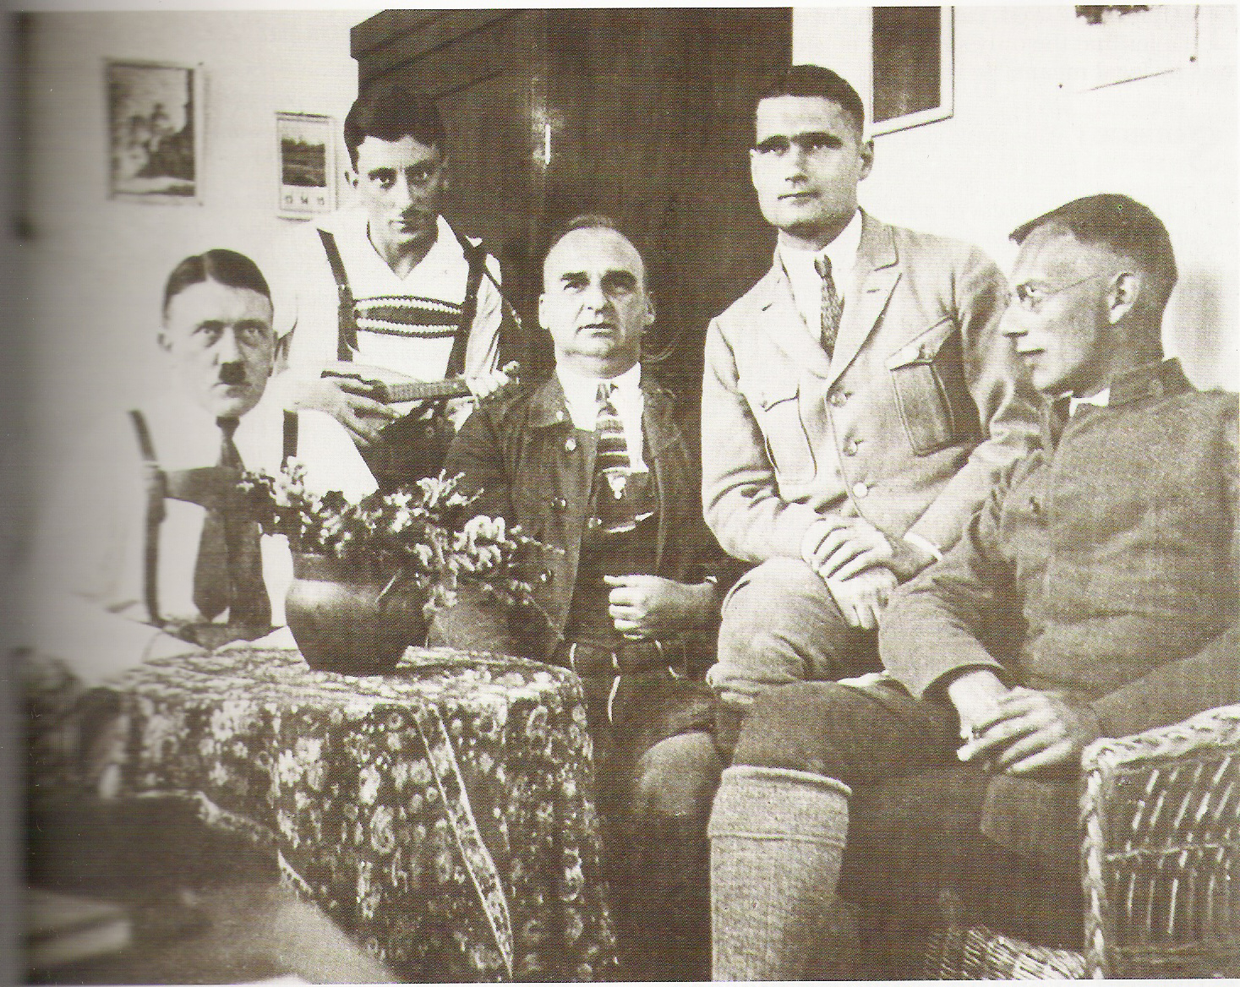
While he was in prison, Hitler thought a lot about how to win power.
rejected the idea of trying to overthrow the Weimar Republic by force
determined not to repeat the mistakes of 1923
Win power LEGALLY
Using DEMOCRACY and ELECTIONS

Slide 5
Just because Hitler was planning legal power, does not mean it turned into a law abiding party. The Nazis and SA got a reputation for violence and fighting in the 1920s.
Fights with German Communist Party and Social Democrats
Violence was planned and encouraged by Nazi leaders
Violence convinced middle class voters that the Nazis were Germany’s toughest anti Communists
Violence got publicity

Slide 6
HITLER’S MESSAGE TO THE GERMAN PEOPLE
The Weimar Republic is weak
The Jews and Communists have caused Germany’s problems
Germans are the master race
Hitler will make Germany great again

Slide 7
Abolish the
Treaty of
Versailles
Remove Jews
from all positions
of leadership in
Germany
No non Germans
to be newspaper
editors
Rearm
Germany
What did the Nazis
stand for in the
1920s?
Destroy
Communism
Strong central
government: FUHRER
Destroy the
Weimar Republic
Challenge terror or violence with your own terror and violence

Slide 8
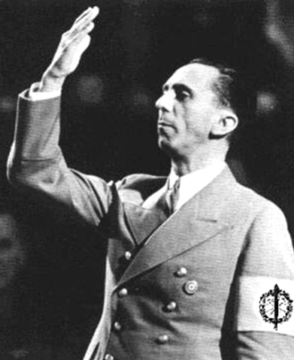
WHAT DID THE NAZIS DO IN THE LATE 1920s?
P43-48
Making the Nazi Party efficient
SA organised with rallies, music, parades and violence. Became polished and strong.
Good at tuning into what Germans wanted to hear
Hitler practiced his ORATORY
Hitler and leading Nazis made PLANS for what do when they came to power
Became very good at PROPAGANDA- Josef Goebbels
False/ twisted information put out to win people’s support
Spread by speeches, posters, Nazi newspapers etc

Slide 9
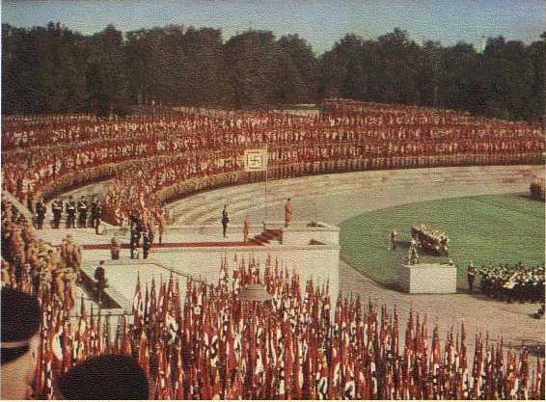

Slide 10
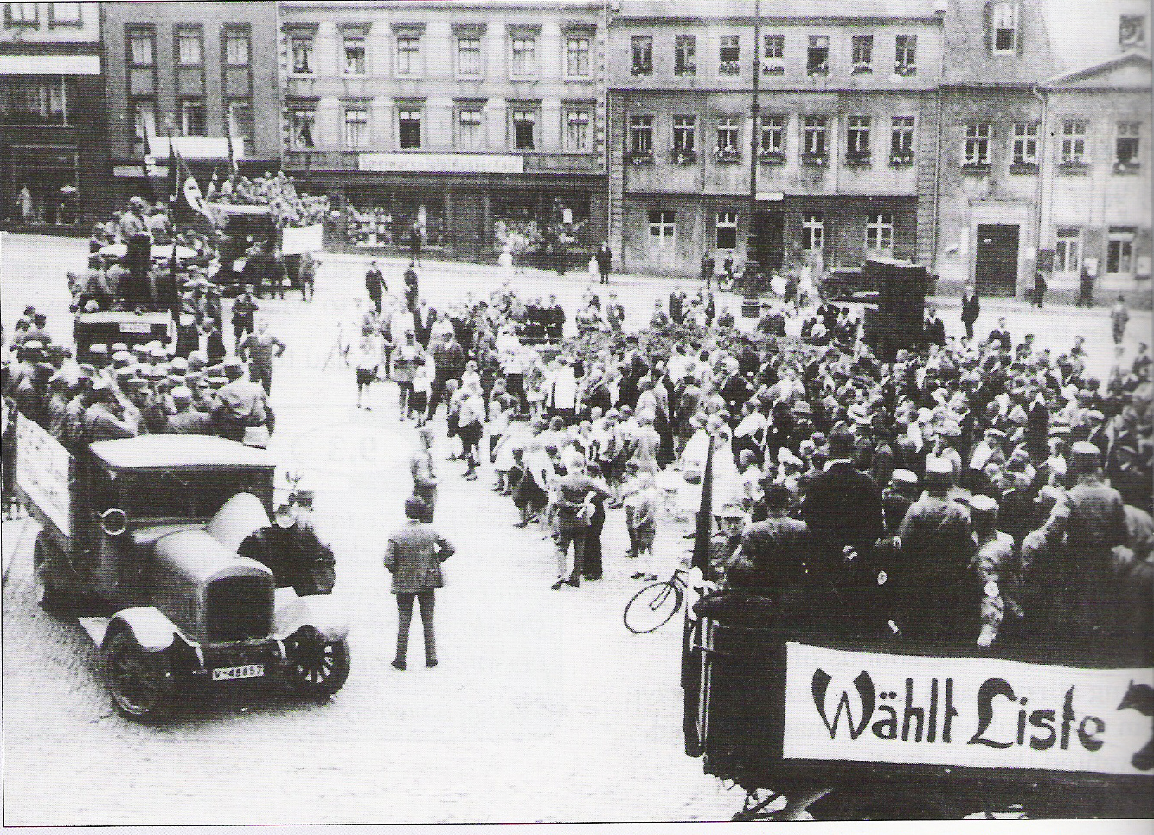

Slide 11
HOW DID HITLER GET HIS MESSAGE TO THE GERMAN PEOPLE?
p43- 48
MODERN TECHNOLOGY- planes to travel around Germany quickly on speaking tours. First politician to use planes.
POSTERS & SLOGANS- repetitive, very simple and effective
Hitler’s ORATORY
METHODS OF
PUBLICITY
PARADES
Exploited MASS MEDIA ( newspapers, radio, cinema newsreels)
RALLIES & MARCHES- NAZI SYMBOLS
PROPAGANDA- organised by Goebbels
SA – uniforms, marching bands

Slide 12
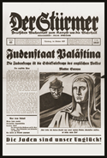


Articles on ‘enemies of the state’ eg Jews etc
WHO LISTENED TO THE NAZI’S MESSAGE?
working classes in cities
farmers & small towns
middle classes, small businessmen etc
Despite the problems facing Weimar Germany, during the 1920s the Nazis actually achieved very little success. It was not until the difficult Depression years of the early 1930s that the Nazis made a real impact on Germany.

